Slide 1
Project:
Plan, Reduce, Repeat
[VietLT]:
[22-OCT-2023]

Slide 2
Overview:
You have recently joined the SRE team for an exotic plant reseller startup. They already have a small SRE team in place consisting of two other members. You are just finishing up your training period and are now ready to be on your own.
You have a busy week ahead of you as there is a release this week plus your on-call shift. Part of your release duties includes helping to maintain the as-built document by adding this new release, as well as planning for system resource changes. For your on-call shift, you have to respond to alerts as they come in and write up an on-call summary to document your shift. Finally, you’ll round out your week by helping to reduce toil. You will have to identify any toil you encounter throughout the week and create a toil reduction plan. After you have a plan all ready, you will need to work on implementing that plan by writing some scripts to help automate tasks.

Slide 3
Scenario 1
Release Day

Slide 4
Release Night
Summary
Tonight is release night, and it will be your first time assisting with a release as an SRE. The process now is manual, with no real consideration for how releases may impact resource allocation. Luckily, your other team members have started implementing an as-built document. You'll have to add tonight's release to the document. The release is a pretty major release with the addition of a new feature that will bring in a large number of new clients. Looking at the results from testing, you can see that this new feature is going to add additional resource requirements as it is both more memory and, to a lesser extent, CPU intensive than before.
Current Release Features
This release will have the following changes that will need to be documented on the as-built design document. The developers have been hard at work implementing the following tickets:
Ticket 203 added a new catalog for exotic plants. This ticket added new tables in the database to handle the additional catalogs.
Ticket 202 rearranged the catalog menu in the UI to accommodate the additional catalog, as well as making it more user-friendly.
Ticket 201 added an additional component to the application, an order processor. The order processor is responsible for batch processing orders on a schedule. The reasoning behind this was to decouple the UI from order processing, and since order processing can be CPU intensive, this decoupling prevents the app from performing poorly. The Design Doc 5247 goes into more detail about the design specifics.
Ticket 205 fixed a security flaw where attackers could execute a SQL injection attack.

Slide 5
Release Night, cont.
Release Process
The established release process is a manual affair generally done by one of the operations team members. The OPs team generally will download the latest code, shut down the app, run the database migrations, change or add any needed configurations and then start the app back up. In the past this has caused issues as steps have been forgotten, not all the scripts were executed, the app was not restarted properly, among other issues. During the release window, the OPs engineer would also add new resources as needed. This has led to downtime in the past as the app became overloaded and could not serve requests anymore.
Release Planning
During load testing for this release, it was determined that
Main Application
The new catalog feature increases RAM usage by 25% for the same number of users while not increasing CPU significantly. Currently, the main application containers utilize almost 85% of the RAM allocated.
At the current resource allocation, each replication can handle 500 concurrent users. Currently, there are 3 application containers to support 1500 total users. This release is expected to add about 2.5 times the total number of users.
Order Processor
This component has a high CPU utilization with moderate RAM requirements. In testing, a fully loaded queue used a bit less than 1 Gb of RAM.
The component runs with 4 concurrent processes, pulling orders from the database and processing them for fulfillment. QA recommends twice the CPU as the main application.
Database
The database was provisioned to handle a much larger application than what the company has now and passed the load tests with flying colors.

Slide 6
As-Built Doc Template
Release Version
Stakeholders
These are the teams and members involved in this reason. This should include ops members, developers, SRE members, database admin, etc
Code Changes
This section should include a list of code changes going into this release separated into groups (for example, by bug fix, feature addition, and security fixes). This should be a short summary of the change with a ticket included to follow up with for more detailed information.
Data and System Changes
This should be formatted similarly to the code changes section, except listing any changes to the data model (database or API changes) or system changes.
Design decision highlights
Document the high-level reasoning behind any design choices. This section should only include a summary of the design decision with links to supporting documentation to follow up with for more detailed information.
Test Section
In this section, list any notable highlights from testing. Things to include here would be any changes to the testing methodology, changes to the test performed, and any tests that are not currently pass (or pass with a warning).
Deployment Notes
Include any changes made to the deployment process or any changes that should be made to improve in feature releases.

Slide 7
As-Built Doc Release 1
Stakeholders
Developers
John Doe
Jane Peters
Sam Ross
Ops
Jay Smith
SRE
John Robert
Code Changes
Security fixes
Added new password requirements (Tk-100)
Fixed how SQL queries were handled (Tk-103)
Feature Additions
Added new menu options for users (Tk-102)
Users can now have middle names (Tk-101)
Data and System Changes
Data model changes
Added columns for middle names in user table (TK-101)
Added additional New Menu table (Tk-102)
Users table was split into 2 smaller tables (TK-101)

Slide 8
As-Built Doc Release 1
Design decision highlights
Users table was split into two smaller tables to create more efficient queries and mappings. Keeping it as one big table began to cause slow queries and allowed for a larger number of users. See Design Doc 134 for further discussion.
Test Section
All test suites are passing 100%.
Deployment Notes
The database admins asked for an additional set of scripts to be run for data corrections.

Slide 9
Deployment File
Release 1
ApiVersion: apps/v1
kind: Deployment
metadata:
name: app-deployment
namespace: course4
labels:
app: mainApp
spec:
replicas: 3
selector:
matchLabels:
app: mainApp
template:
metadata:
labels:
app: mainApp
spec:
containers:
- name: mainApp
image: nginx:latest
resources:
requests:
memory: 256mb
cpu: 250m
ports:
- containerPort: 80

Slide 10
As-Built Doc Release 2
Write the As-Built Doc for this new release here. Add more pages if needed.
Stakeholders
Developers
John Doe
Jane Peters
Sam Ross
Ops
Jay Smith
SRE
John Robert
Code Changes
Security fixes
Fixed a security flaw where attackers could execute a SQL injection attack..(Tk-205)
Feature Additions
Rearranged the catalog menu in the UI to accommodate the additional catalog, as well as make it more user-friendly.(Tk-203)
Data and System Changes
Data model changes
Added a new catalog for exotic plants. This ticket added new tables in the database to handle the additional catalogs. (TK-203)

Slide 11
Deployment File
Release 2
Update the file for Release 2 to match the description in the scenario:
ApiVersion: apps/v1
kind: Deployment
metadata:
name: app-deployment
namespace: course4
labels:
app: mainApp
spec:
Replicas: 8
selector:
matchLabels:
app: mainApp
template:
metadata:
labels:
app: mainApp
spec:
containers:
- name: mainApp
image: nginx:latest
resources:
requests:
memory: 512mb
cpu: 250mb
ports:
- containerPort: 80
- name: order_processor
image: nginx:latest
resources:
requests:
memory: 1gb
cpu: 512mb
ports:
- containerPort: 80

Slide 12
Scenario 2
On-Call Shift

Slide 13
On-Call Shift
Summary
Today is your first on-call shift as an SRE. During your shift, you will have to respond to alerts to keep the system running at its best using the on-call best practices learned in this course. During your on-call shift, make sure to be thinking of ways to reduce toil. After your on-call shift is over, you will be responsible for writing a summary of your shift and a post-mortem. On the following slides you will encounter several different “alerts” from your monitoring stack. Each “alert” will contain several different parts that will help you write your on-call log for your shift. Additionally, you’ll encounter an application outage that will require a post-mortem.
Alert Components
Summary -- This will be general knowledge about the systems involved that you would know if you had actually been working at the company. It will include a brief description of the systems involved as well information about how it is managed.
Standard Operating Procedure (SOP) -- This will be a short description of the steps to troubleshoot and potentially correct the cause of the alert.
Log and Monitoring Details -- This section will contain snippets of relevant logs and monitoring data (graphs, metrics, etc.) that are associated with responding to an alert.
On-Call Log
After your on-call shift you’ll need to add to the on-call log. There is a provided sample template for you to use that includes all the necessary fields. Remember your on-call log is used to help track recurring alerts/issues as well as providing a record of the steps taken to resolve the issue.
Post-Mortem
Unfortunately there will be an application outage on your shift that will require a post-mortem. You will only be responsible for filling in your involvement, plus you’ll be in charge of creating an action plan and impact assessment.

Slide 14
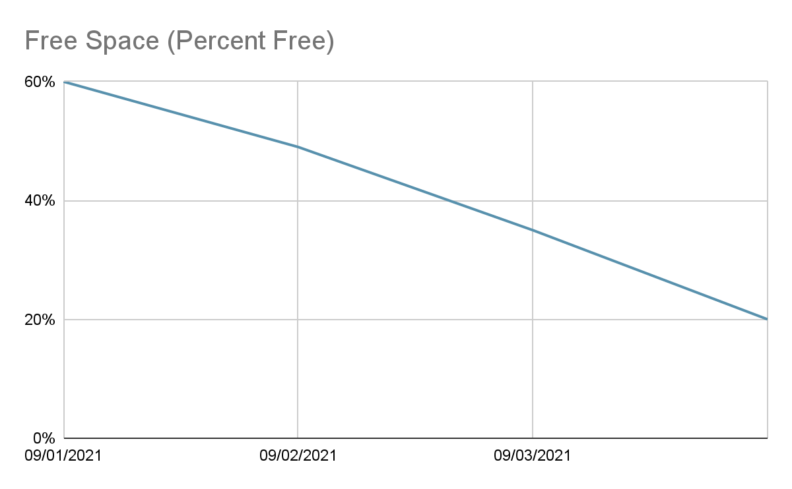
On-Call Shift -- Alert 1
Low Storage Alert
Summary
You receive an alert that the storage is running out on the mount where application logs are being written to. After consulting the SOP, you reach out to the team responsible for the server. They respond that Steve is normally in charge of handling the logs. Every morning he would run the commands listed in the run book, but he has been out sick for a week. The other members of the team forgot that it needed to be done, so the mount filled up.
SOP
Log/Monitoring Details
Low Storage
Depending on the specific alert take the following action:
/home/sre/course4/app.log -- If this mount is low on storage, reach out to Compliance. They will know what logs can be cleared out or will request additional storage.

Slide 15
On-Call Shift -- Alert 2
DNS Troubles
Summary
The networking team recently added a secondary backup DNS server to increase reliability since the one they are using now tends to go down frequently. Your team has several checks in place monitoring the DNS servers to make sure they are up at all times.
SOP
DNS Server Not Answering Requests
If you receive this alert, you should check to see if DNS1 or DNS2 is the current server answering requests. After determining which is the active server, check to see if the server is reachable. If the server is not reachable, immediately initiate the failover procedure to prevent any further network disruptions. If the server is reachable, check the logs to determine what the error is. If the active server cannot be brought back online within 5 mins, initiate the failover procedure. Either way, engage the Networking team to bring the standby server back online.
Failover Procedure
Determine the active server with the dnsTool.
dnsTool -q active_server
If the active server is reachable you can initiate the shutdown process. If this command fails, make sure the dns process is shutdown on the server before continuing
dnsTool -a shutdown -s dns1
Start the failover.
If shutdown was successful: dnsTool -a failover -s dns2
If shutdown was not successful, include the force flag, dnsTool -a failover -s dns -f

Slide 16
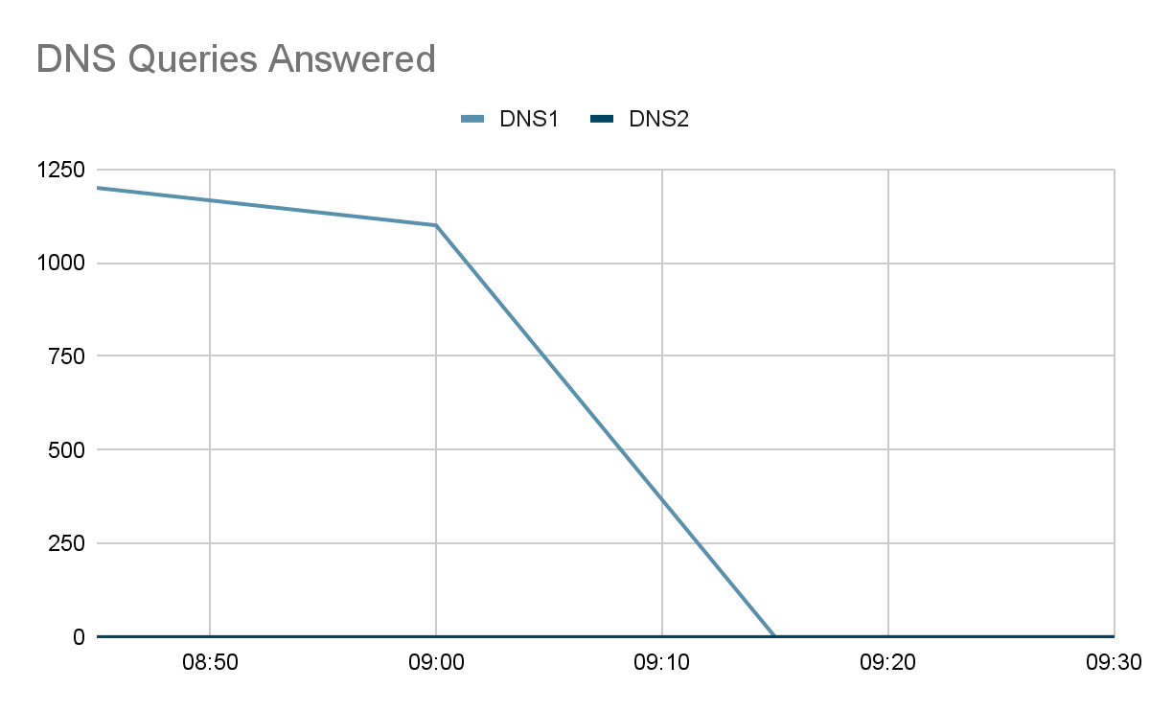
On-Call Shift -- Alert 2
DNS Troubles, cont
Log/Monitoring Details
Networking Server Status Page
Server | Status
DNS1 | UP
DNS2 | UP

Slide 17
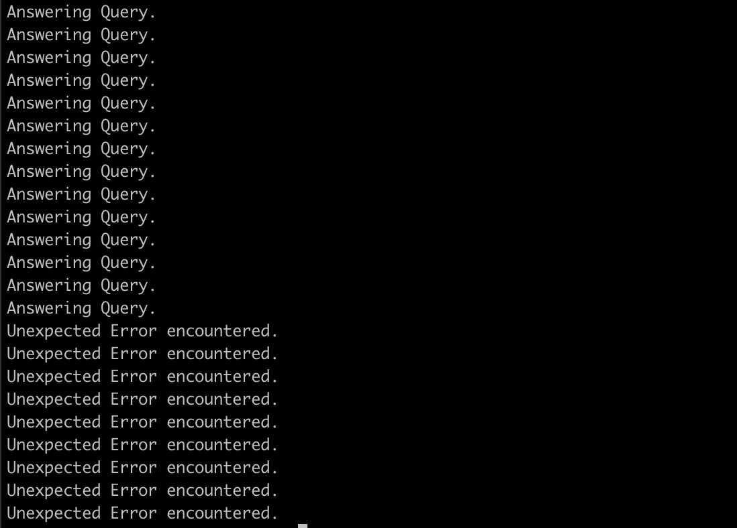
On-Call Shift -- Alert 2
DNS Troubles, cont
Log/Monitoring Details

Slide 18
On-Call Shift -- Alert 3
Application Outage
Summary
You receive the dreaded Application Down alert. Not only do you receive an alert for the application being down, but Customer Support also sent out a page to get all hands on deck for a report of the application being down.
SOP
Log/Monitoring Details
Application Down
If you receive this alert, you need to act immediately. First, verify the application is indeed unreachable. If the application is unreachable, check to make sure the hosts are up and the application processes are running. You must start escalation for this immediately after verification the app is unreachable. Contact the following POCs:
Customer Support -- Susan Vega
Networking -- Bob Sparrow
Ops -- Glen Hammer
Database Admin -- Karen House
Development Team – Gal Tree
Main App Status
Endpoint or Host | Status
exoticplant.plant | UNREACHABLE
planthost1.internal | UP
planthost2.internal | UP
exoticplant.plant.internal | UNREACHABLE

Slide 19
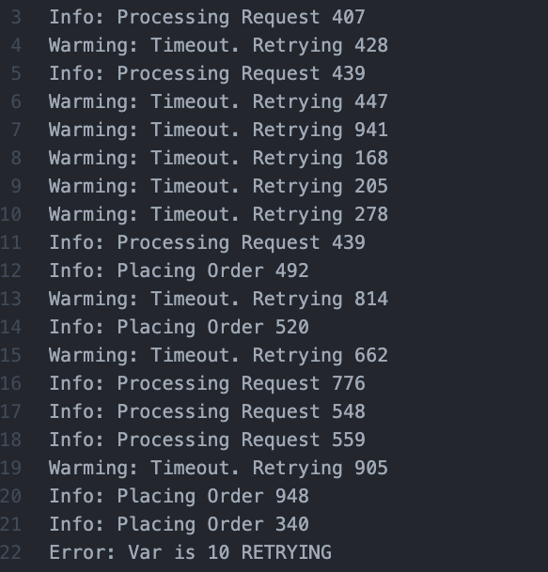
On-Call Shift -- Alert 3
Application Outage, cont
Log/Monitoring, cont.

Slide 20
On-Call Shift -- Alert 3
Application Outage, cont
Log/Monitoring, cont.
09:15 Hey we have reports of an application outage and we can not reach the app either. FROM: svega
09:16 I have an alert for that too. I’m looking at things now, will start a communication channel to coordinate. Checking logs and app servers now. FROM: YOU
09:20 -- !svega !bsparrow !ghammer !khouse !gtree we have an application outage FROM: YOU.
0930 -- Everything looks good from the network FROM: sparrow
0932 -- I can access the DB and it is reporting back normal FROM: khouse
0935 -- Everything here looks normal. FROM: ghammer
0937 -- We are still reviewing logs and seeing if we can reproduce on our end FROM: gtree
0938 -- We should try restarting the app, Maybe that will help FROM: ghammer
0940 -- Maybe that will help. FROM: svega
0943 -- Okay I will try. Bringing down. FROM: YOU
0945 -- App is down. Bring back up. FROM: YOU
0947 -- App is starting. FROM: YOU
0952 -- Main app is back up. FROM: hammer
0955 -- App is still not respond. FROM: svega
0956 -- I’m sending you some new logs !gtree these look off FROM: hammer
1005 -- !sre !ghammer when was the last deploy? What were the details? This looks like a qa build. FROM: gtree
1007 -- I did a deploy with one of the devs to qa to do some testing. Let me check. FROM: ghammer
1010 -- I think there was a mixup when doing the deployment. The wrong scripts was used and that build was deployed to prod. FROM hammer
1011 -- Were there any migrations for that !ghammer FROM: khouse
1012 -- No, just code changes. FROM: hammer
1013 -- Thats good. We should be able to just revert back then. !svega
1015 -- Let me take down the app and redeploy it. FROM: YOU
1017 -- App is down. Bring back up. FROM: YOU
1023 -- App is starting. FROM: YOU
1026 -- Main app is back up. FROM: hammer
1030 -- Everything looks like it is responding now. FROM: svega

Slide 21
On-Call Summary Log Template
09/04/2021 -- Low Storage Alert
Troubleshooting
/home/sre/course4/app_log -- If this mount is low on storage, reach out to Compliance. They will know what logs can be cleared out or will request additional storage.
Resolution Solution: Run the commands from the run book.
How to prevent: Every body in Steve’s team should have a copy of this run book, and should have all in standby mode. So whenever Steve is out cold again, anyone from his team will take on the task and perform the commands listed in the book.

Slide 22
On-Call Summary Log Template
9:00 ~ 9:15 -- DNS Troubles
Troubleshooting
If you receive this alert, you should check to see if DNS1 or DNS2 is the current server answering requests. After determining which is the active server, check to see if the server is reachable. If the server is not reachable, immediately initiate the failover procedure to prevent any further network disruptions. If the server is reachable, check the logs to determine what the error is. If the active server cannot be brought back online within 5 mins, initiate the failover procedure. Either way, engage the Networking team to bring the standby server back online.
Failover Procedure
Determine the active server with the dnsTool: dnsTool -q active_server
If the active server is reachable you can initiate the shutdown process. If this command fails, make sure the dns process is shutdown on the server before continuing: dnsTool -a shutdown -s dns1
Start the failover.
If shutdown was successful: dnsTool -a failover -s dns2
If shutdown was not successful, include the force flag: dnsTool -a failover -s dns -f
Resolution
Solution: Perform failover procudure to switch over to the other DNS.
How to prevent: create auto failover for them

Slide 23
On-Call Summary Log Template
9:15~10:30 -- Application Outage
Troubleshooting
First, verify the application is indeed unreachable. If the application is unreachable, check to make sure the hosts are up and the application processes are running. You must start escalation for this immediately after verification the app is unreachable. Contact the following POCs:
Customer Support -- Susan Vega
Networking -- Bob Sparrow
Ops -- Glen Hammer
Database Admin -- Karen House
Resolution
Contact with POCs to get them on helping finding the root cause, and after finding out the root cause, continue to work on a solution.

Slide 24
Post-Mortem
Application Outage -- 9:15~10:30
Stakeholders
Customer Support -- Susan Vega
Networking -- Bob Sparrow
Ops -- Glen Hammer
Database Admin -- Karen House
Development Team – Gal Tree
SRE - Me
Incident Timeline
09:15 Hey we have reports of an application outage and we can not reach the app either. FROM: svega
09:16 I have an alert for that too. I’m looking at things now, will start a communication channel to coordinate. Checking logs and app servers now. FROM: YOU
09:20 -- !svega !bsparrow !ghammer !khouse !gtree we have an application outage FROM: YOU.
0930 -- Everything looks good from the network FROM: sparrow
0932 -- I can access the DB and it is reporting back normal FROM: khouse
0935 -- Everything here looks normal. FROM: ghammer
0937 -- We are still reviewing logs and seeing if we can reproduce on our end FROM: gtree
0938 -- We should try restarting the app, Maybe that will help FROM: ghammer
0940 -- Maybe that will help. FROM: svega
0943 -- Okay I will try. Bringing down. FROM: YOU
0945 -- App is down. Bring back up. FROM: YOU
0947 -- App is starting. FROM: YOU
0952 -- Main app is back up. FROM: hammer
Impact
Resolution
Action Plan

Slide 25
Post-Mortem
0955 -- App is still not respond. FROM: svega
0956 -- I’m sending you some new logs !gtree these look off FROM: hammer
1005 -- !sre !ghammer when was the last deploy? What were the details? This looks like a qa build. FROM: gtree
1007 -- I did a deploy with one of the devs to qa to do some testing. Let me check. FROM: ghammer
1010 -- I think there was a mixup when doing the deployment. The wrong scripts was used and that build was deployed to prod. FROM hammer
1011 -- Were there any migrations for that !ghammer FROM: khouse
1012 -- No, just code changes. FROM: hammer
1013 -- Thats good. We should be able to just revert back then. !svega
1015 -- Let me take down the app and redeploy it. FROM: YOU
1017 -- App is down. Bring back up. FROM: YOU
1023 -- App is starting. FROM: YOU
1026 -- Main app is back up. FROM: hammer
1030 -- Everything looks like it is responding now. FROM: svega
Impact
Business: the downtime is from before 9:15 to 10:30, around 1 hours 15 minutes, give or take. In this time frame, the website is unable to process anything, this would cause a huge loss of revenue for business.
Customer: the buyers could not buy or process order in this time frame. Which may lead to them leaving the app, damaging the image and credibility of the customer.
Data: this also affect the data that are in transition or being process
Resolution
The solution was to shut down the program and re-deploy the code.
Action Plan

Slide 26
Post-Mortem
Infrastructure: cloud infrastructure can be utilized.
HA: to provide high availability for databases and applications, let's add additional components.
Deployment: Some methods such as rolling deployment, canary deployment, and blue-green deployment might be used to implement the release.
Automation: To reduce risk, CI/CD should be applied.

Slide 27
Scenario 3
Toil Reduction

Slide 28
Toil Reduction Plan
Summary
Now that you have spent some time on your own as an SRE, you now have to round out your week by handling some of the toil you encountered. Looking through the on-call summary, post-mortem, as-built design doc, and your experience, you decided that there are several ways to reduce toil. You need to list out 4 of the major items for this week, explain the reason for choosing each item briefly, and provide at least one benefit automating the toil would have. After that, you will need to implement two of these items in pseudocode to help your team move forward.
Toil Items | Why it is considered toil? | Benefits of automating
Restart the main application | This item can be triggered and can execute automatically by scripts | Saving time in repetitive tasks
Failover DNS | This item can be triggered and can execute automatically by scripts | Saving time in repetitive tasks
Low storage | This item can be triggered and can execute automatically by scripts | Saving time in repetitive tasks
Clean old backup files | This item can be triggered and can execute automatically by scripts | Saving time in repetitive tasks

Slide 29
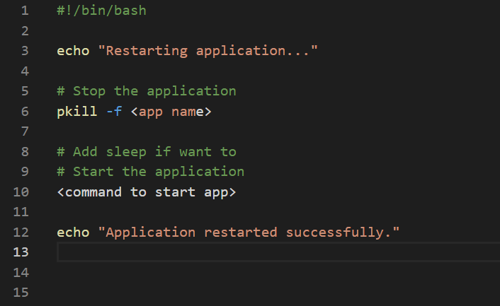
Automation Implementation
Restart the main application:

Slide 30
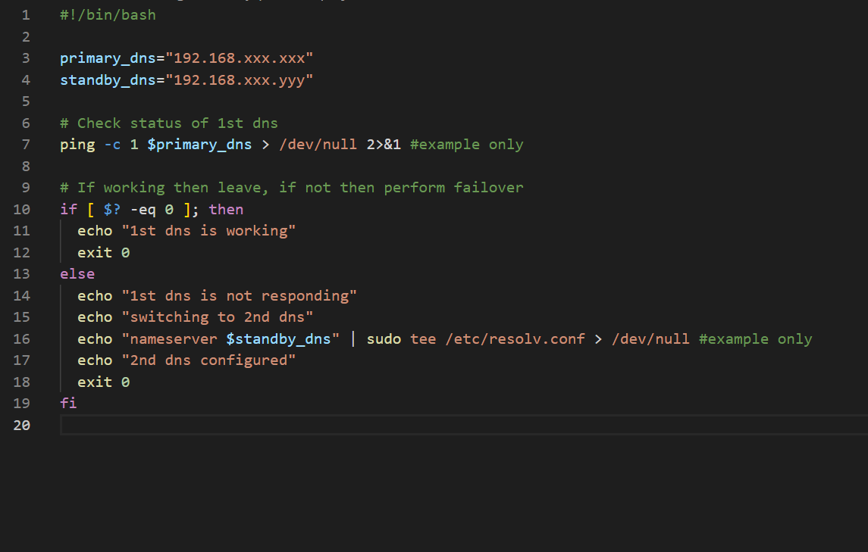
Automation Implementation
Failover DNS:

